Slide 1



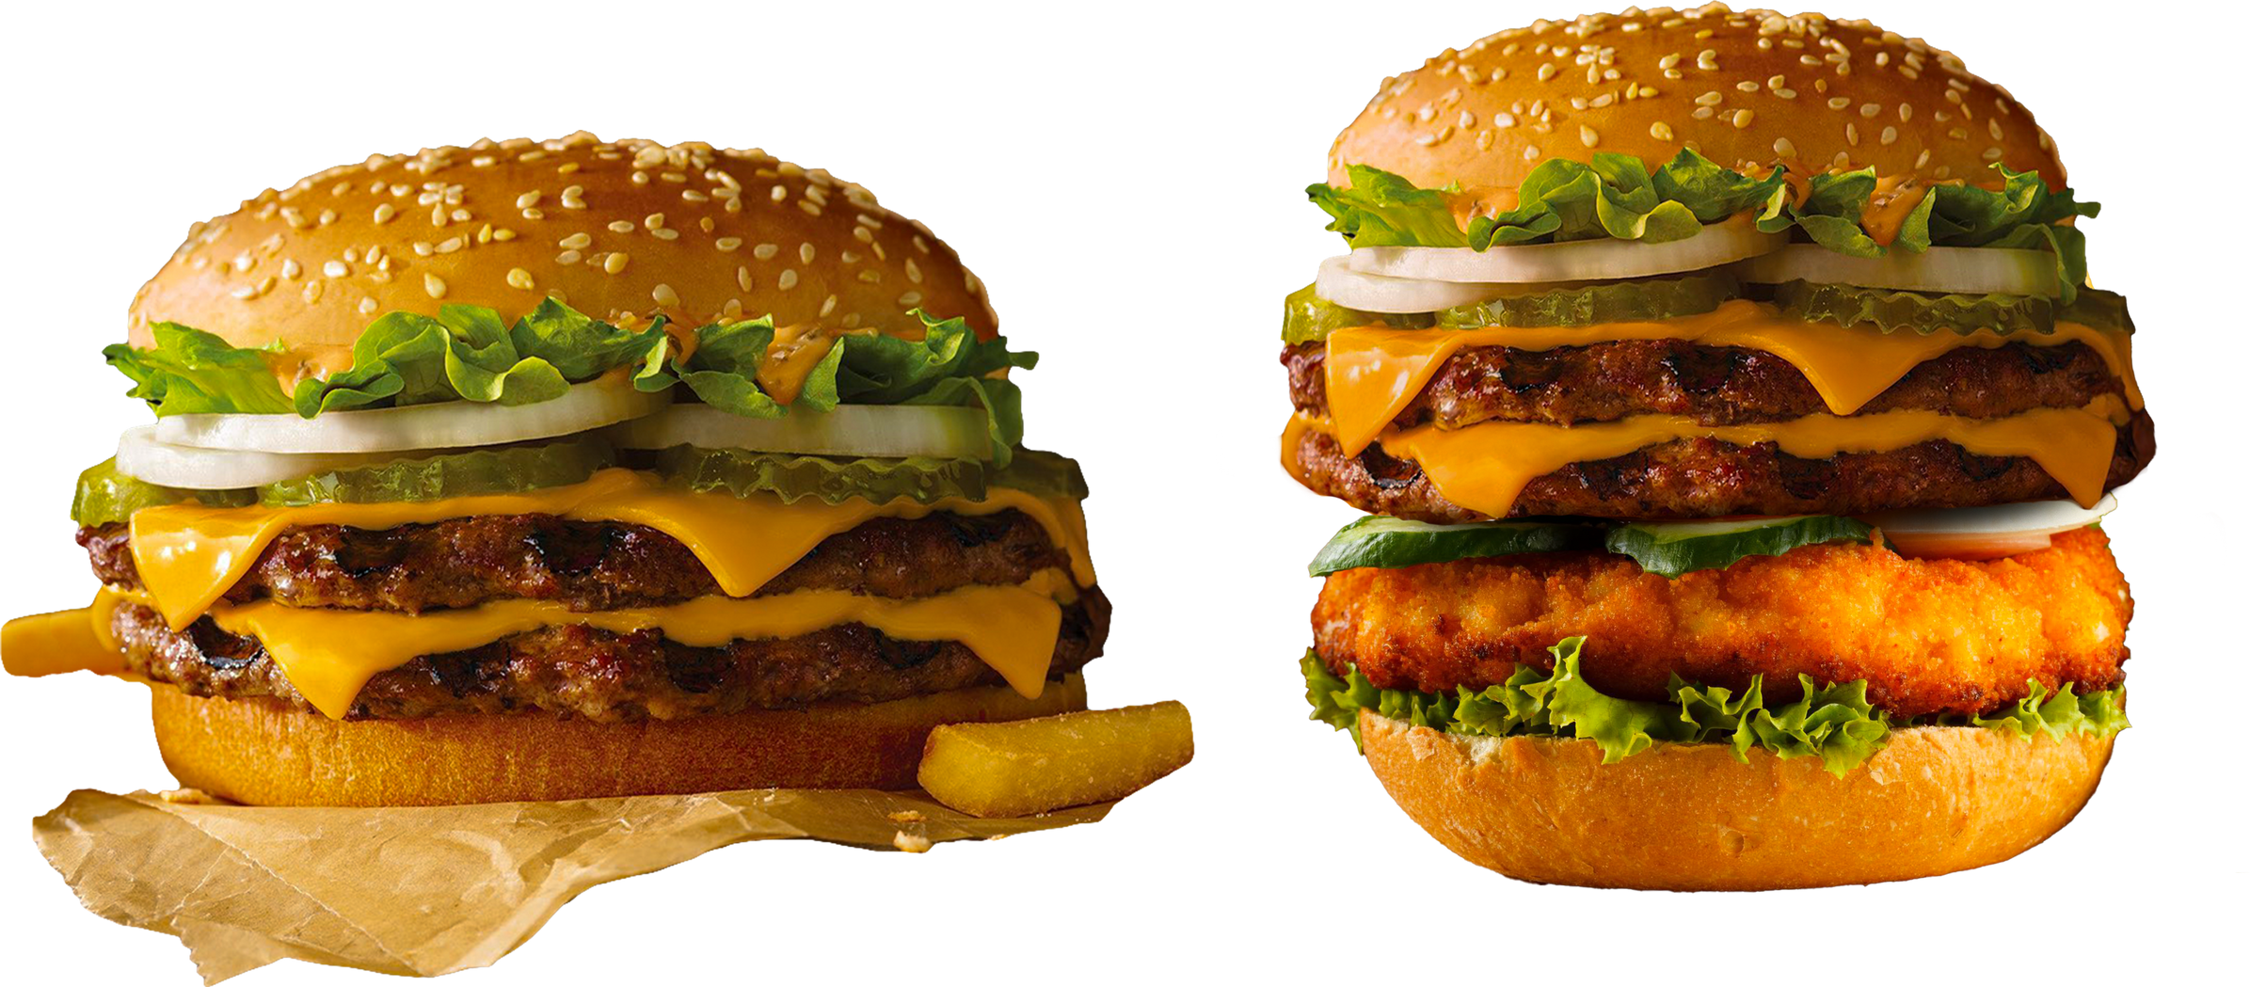



ABC FAST FOOD
ABC FAST FOOD
FASTEST GROWING FAST FOOD CHAIN
FRANCHISE OPPORTUNITY

Slide 2


ABC FAST FOOD
SPEAKER
Chethan P P
Buisness Analyst
ABC FAST FOOD

Slide 3
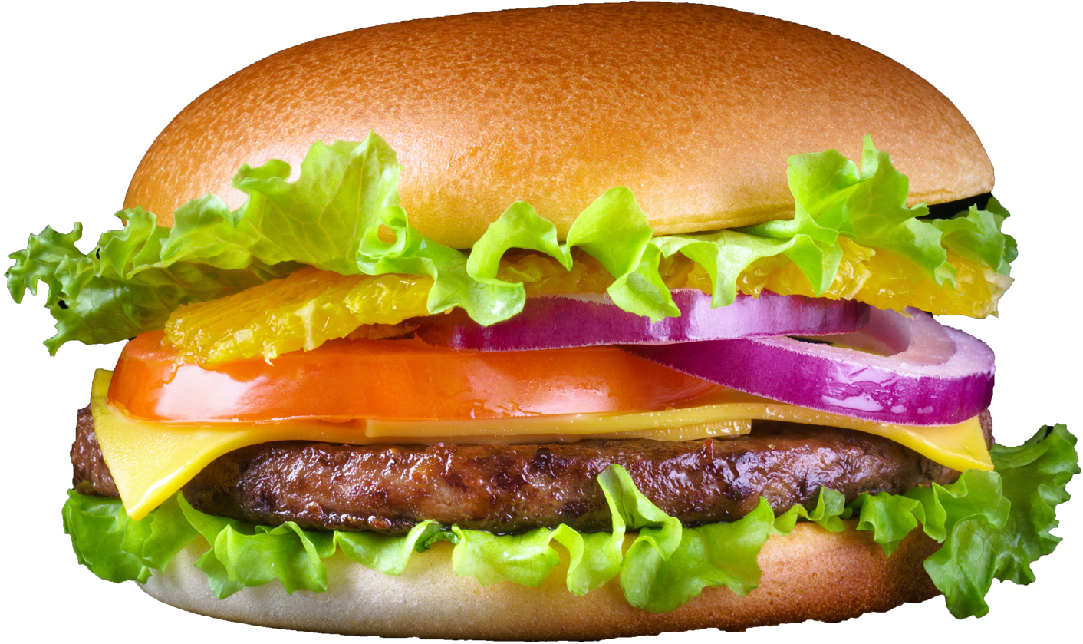

ABC FAST FOOD
INDUSTRY OVERVIEW
Rapid Market Expansion: The fast food industry in India is expected to grow significantly in the coming years, with the market size projected to reach around ₹4,23,000 crore by 2025.
Rise of Quick-Service Restaurants (QSRs): QSRs like ABC Fast Food are becoming increasingly popular due to their fast, affordable, and tasty offerings. The segment is expected to grow at a CAGR of 18-20% over the next few years.
Young Consumers: The youth market, which loves convenience and variety, will continue to drive demand in the fast food sector.

Slide 4

ABOUT US
ABC FAST FOOD
At ABC Fast Food, we believe in redefining the way India enjoys its favorite meals. Born out of a passion for great taste and convenience, our brand is dedicated to delivering delicious, high-quality food that brings people together.
We pride ourselves on being more than just a fast food chain; we’re a culinary experience that combines the flavors you love with the speed and efficiency you need. From our signature pizzas to our mouth-watering burgers and crispy chicken dishes, every item on our menu is crafted with care, using only the freshest ingredients.
What sets ABC Fast Food apart is our commitment to innovation and customer satisfaction. We constantly explore new recipes and adapt to the evolving tastes of our customers, ensuring that every visit to our outlets is a delightful experience. With a keen focus on quality, hygiene, and sustainability, we are not just serving food—we are setting new standards in the fast food industry.
As we expand across India, our vision is to make ABC Fast Food a household name, synonymous with flavor, fun, and a sense of community. Join us on our journey to revolutionize the fast food experience, one bite at a time.

Slide 5
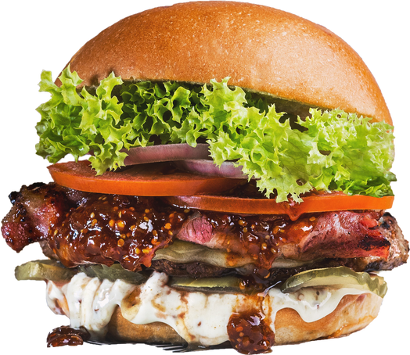




ABC FAST FOOD
OUR MENU: SIGNATURE DISHES
Juicy ABC Burger
Crispy Loaded Fries
Classic Pizza
Tandoor Chicken
Hot Chocolate

Slide 6
ABC FAST FOOD
OUR
GOALS
1. Achieve Market Penetration
2. Ensure Consistent Quality and Service
3. Drive Profitability for Franchisees
4. Foster Brand Loyalty and Customer Satisfaction
5. Innovate and Adapt to Market Trends
6. Strengthen Brand Identity and Market Position

Slide 7
OUR STRENGTHS
ABC FAST FOOD
Strong Brand Identity:
Established reputation for quality and consistency in the fast food sector.
Recognizable brand that appeals to a wide audience.
Diverse Menu Offerings:
A varied menu that includes popular items like pizzas, burgers, and fried chicken.
Ability to cater to different tastes and preferences, attracting a broad customer base.
Operational Efficiency:
Well-developed systems for food preparation and service.
Streamlined processes that enhance customer experience and reduce wait times.
Marketing and Promotional Strengths:
Effective marketing strategies and promotional campaigns that drive brand awareness.
Strong digital presence and engagement through social media and online ordering platforms.

Slide 8

CHALLENGES
ABC FAST FOOD
Changing Consumer Preferences:
Evolving tastes and dietary preferences may shift away from traditional fast food offerings.
Need to continuously adapt the menu and marketing strategies to meet changing consumer demands.

Slide 9
OPPORTUNITIES
ABC FAST FOOD
Market Expansion:
Growing urbanization and increasing disposable incomes create opportunities for opening new outlets, especially in Tier 2 and Tier 3 cities.
Expansion into underserved areas with high growth potential.
Technology Integration:
Leveraging advancements in technology for improved customer experience, such as self-service kiosks and advanced delivery systems.
Expanding online ordering and delivery services to capture a larger market share.

Slide 10
POTENTIAL THREATS
ABC FAST FOOD
Supply Chain Disruptions:
Potential disruptions in the supply chain due to factors like geopolitical issues, natural disasters, or logistical challenges.
Impact on ingredient availability and cost stability.

Slide 11
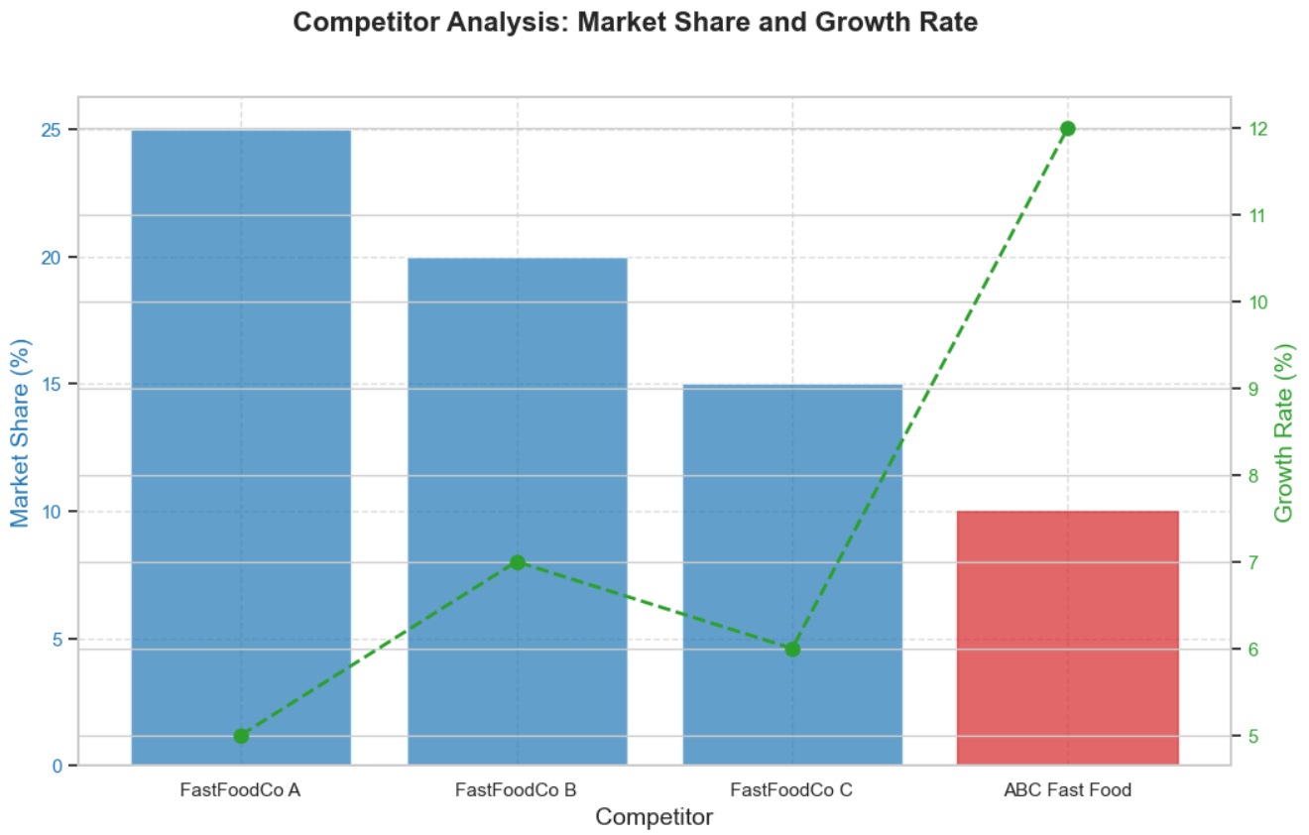
COMPETITOR
ANALYSIS
ABC FAST FOOD

Slide 12
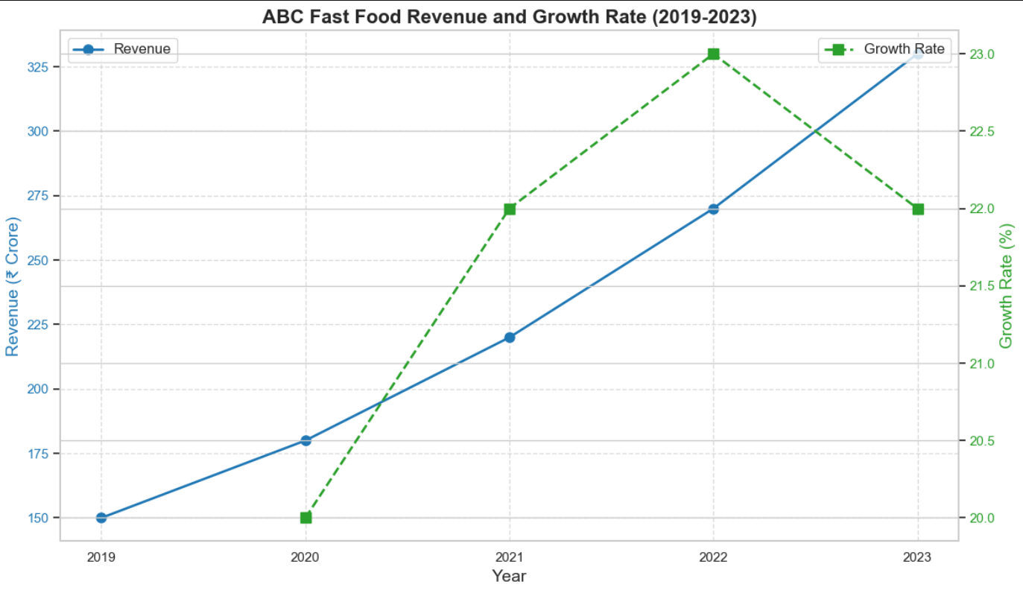
GROWTH ANALYSIS
ABC FAST FOOD

Slide 13
WHY US ?
ABC FAST FOOD
1. Proven Success
Rapid Growth: Significant market expansion and increasing sales.
Strong ROI: Attractive returns with a quick payback period.
2. Unique Offerings
Innovative Menu: Diverse and exclusive fast food options.
Brand Strength: Well-established reputation and strong market presence.
3. Aesthetic Appeal
Modern Design: Trendy and inviting store layouts.
Customer Experience: Focus on creating a pleasant dining environment.
4. Location Management
Prime Locations: Flexible options in high-traffic areas.
Strategic Site Selection: Assistance with choosing the best locations.
5. Comprehensive Support
Franchise Training: Full support and guidance for success.
Effective Marketing: Modern strategies to boost visibility and customer engagement.

Slide 14
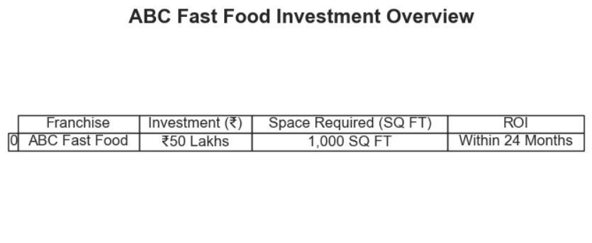
INVESTMENT OVERVIEW
ABC FAST FOOD

Slide 15
ABC FAST FOOD
THANK
YOU !
FOR FURTHER QUERIES PLEASE CONTACT
ppchethan11@gmail.com

